Slide 1
Weiss Center National Advisory Council
Kickoff Meeting
August 24, 2023

Slide 2
Agenda:
1
Welcome & Introduction.
2
Weiss Center Overview, NAC Purpose, & Accessibility.
3
15-minute Break.
4
Service Area Updates: Y1 Successes.
5
Wrap-Up & Next Steps.

Slide 3
Welcome and Introductions (1 of 2).
Weiss Center Staff:
Fred Edora (as Co-Director),
Johan Rempel (as Co-Director),
Bill Huennekens (as Senior Advisor),
June Gothberg (as Accessibility Advisor),
Jennifer Schaaf (as Technical Assistance Lead),
Nichole Bui (as Technology Lead),
Darren Wright (as Dissemination and Communication Lead),
Charlie Silva (as Coordination and Collaboration Lead),
Emily Deaver (as Project Coordinator).
True North Evaluation:
Judy Lee (as External Evaluator).
OSEP Staff:
Krystle Merry (as OSEP Intern).

Slide 4
Welcome and Introductions (2 of 2).
Please introduce yourself: name, organization, role, personal/professional experience with individuals with disabilities.
NAC Members:
Charlotte Alverson,
Christofer Arroyo,
Janice Carson,
Tori Chance,
Cynthia Curry,
Everett Deibler,
John Eisenburg,
Maureen Greer,
Tori Kaufman,
Sarah Massengale,
Jill Hrinda Patten,
Paul Schroeder,
Dr. Helene Shapiro,
Barbara Simpson,
Dr. Andreas Stefik.

Slide 5
Weiss Center Overview
Fred Edora, Johan Rempel, and Charlie Silva

Slide 6
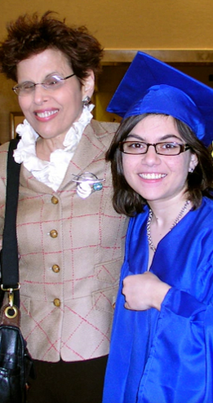
Rhonda Weiss’ Legacy:
It was only after Rhonda Weiss’ passing that her husband Hirsh discovered more about just how extraordinary she was.
According to Hirsh, Rhonda Weiss “kept much of her 41 years as an attorney at the U.S. Department of Education and swashbuckling disability rights advocate to herself.”

Slide 7
Weiss Center Mission:
Content Accessibility is the highest priority in everything we do.
Activities conducted at this center are in remembrance and in honor of Rhonda Weiss.
Broad activities:
Development of a FREE data visualization reporting tool that allows States to publish I D E A Data products that are accessible, usable, and manipulatable by persons with disabilities.
Providing Technical Assistance on making data reporting and publications accessible to persons with disabilities.

Slide 8
The Primary Objectives of the NAC
Advise on I D E A Part B and Part C data collection, reporting, and quality improvement strategies to enhance accessibility
Review and provide feedback on the Center’s projects initiatives, and technical assistance activities
Collaborate with the Center to enhance I D E A data accessibility and dynamic visualizations
Support the dissemination of the Center’s findings, best practices, and recommendations
Foster partnerships and collaborations between the Center and other organizations working in the field of special education and/or accessibility

Slide 9
Logistics of the NAC
Members serve through September 2027.
Meetings will be bi-annually (at minimum) and virtual.
NAC members will be contacted at various times as needed
Contact Fred Edora (fred.edora@aemcorp.com) or Johan Rempel (jrempel3@gatech.edu) with any questions regarding the NAC or of any changes

Slide 10
Y1 Leadership Successes:
Conference Presentations.
Collaboration and Coordination with advocacy groups.
Setting up the Center!
Increasing awareness of the Center
Getting the conversation started around accessibility.

Slide 11
Coordination and Collaboration.
Guiding Principles:
Relationships,
Communication,
Commitment.

Slide 12









Our Partners:

Slide 13









Some of Our New Collaborators:

Slide 14
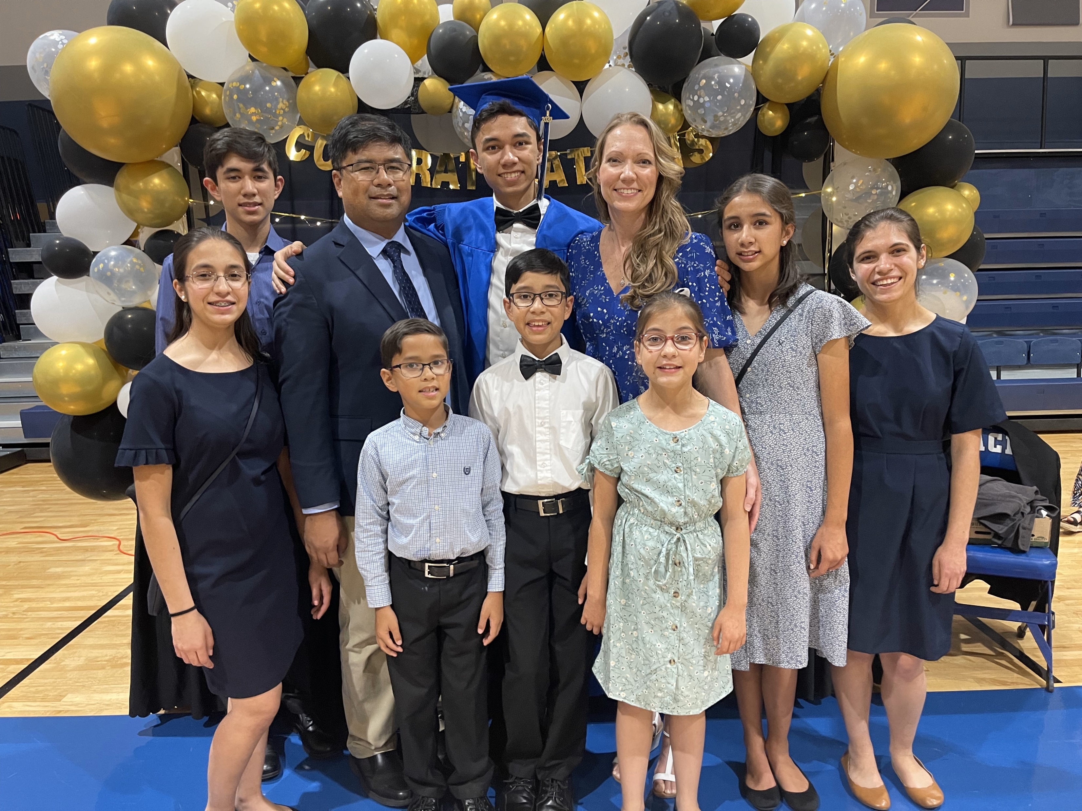
Lived Experience.

Slide 15
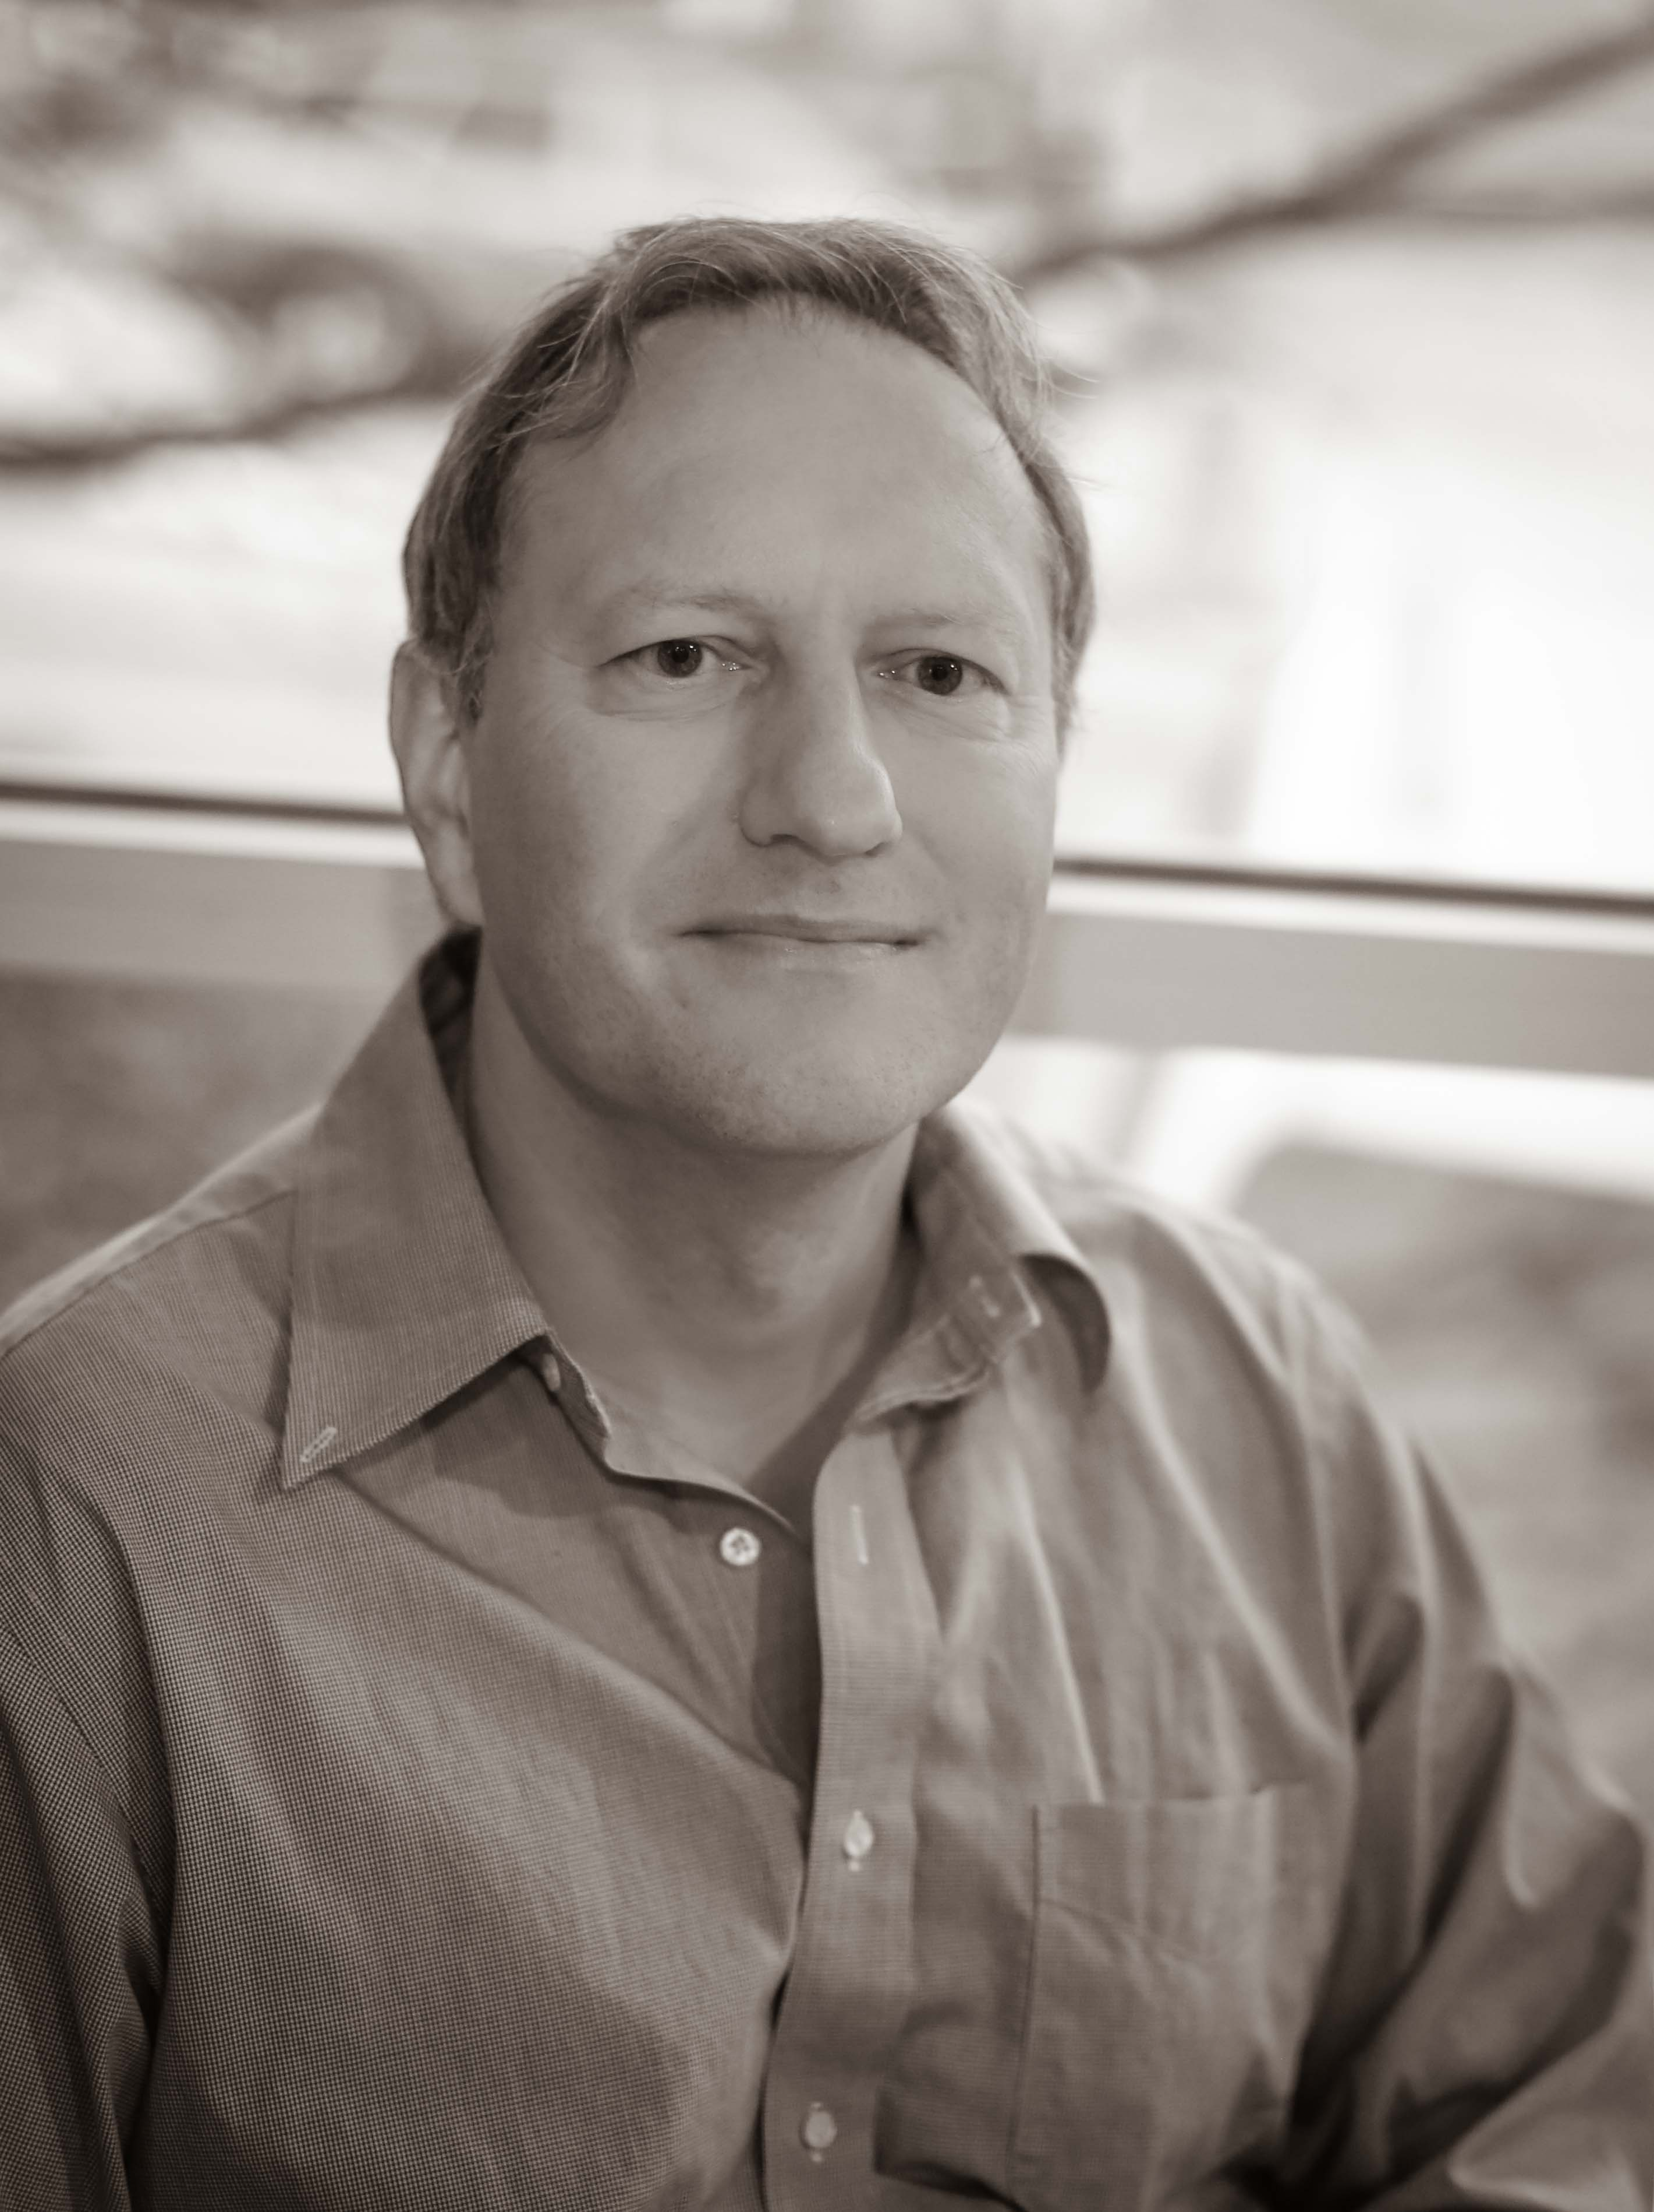
Nothing About Us Without Us.

Slide 16
Accessibility
Johan Rempel and June Gothberg

Slide 17
Achieving Better Accessibility for All.
The Rhonda Weiss Center for Accessible I D E A data is dedicated to promoting equity and inclusion for students and individuals with disabilities.
Achieving better accessibility goes beyond 508 compliance, as the current base level of 508 compliance establishes minimum accessibility requirements.
Our goal is to provide individuals with disabilities full and equal access to I D E A Part B and Part C data in accessible formats.

Slide 18
Accessibility First.
Accessibility is at the heart of everything we do at the center.
You'll hear us talk about:
"accessibility first"
our approach is not an afterthought, it's embedded in every step of our process from conception to dissemination.
"nothing about us without us"
by including people with disabilities early in our product life-cycle we can create better experiences for ALL users.

Slide 19
Accessibility Needs.
We conducted meetings across the country to better understand the data accessibility needs. Stakeholders included:
Part B and C managers,
Accessibility agency leads, specialists, and consultants,
Statewide Longitudinal Data Systems (SLDS) staff,
Advocates,
Family members,
Students.

Slide 20
Accessibility Quotes:
"Accessibility seems to be treated as an afterthought."
"Accessibility is view subjectively instead of as a right."
"Accessibility awareness does not go beyond the Office of Special Education."
"We try but... producing accessible content is difficult and time consuming."
"There are only two team members in the unit that know anything about 508 standards."

Slide 21
Data Accessibility Quotes:
"Besides 508, we don't know how to make data accessible."
"It is not common for people to have knowledge about data accessibility issues."
"States need to understand why making data accessible is important."

Slide 22
Accessibility Document Quotes:
"All [state] documents are spreadsheets – not accessible."
"Current data documents are only presented in various shades of a few colors."
"The font is too small."
"The language is daunting."
"Adding a visual, motor, or cognitive disability bring an extra layer of frustration."

Slide 23
Accessibility System Quotes:
"Data systems are often difficult to navigate."
"Data involves cumbersome tools."
"The biggest challenge is finding the data."

Slide 24
Accessibility Data Use Quotes:
"Families have little or no idea how to access or interpret I D E A data, let alone utilize it to create better outcomes for their children."

Slide 25
Data Accessibility at the Weiss Center.
The Weiss Center will provide resources and support to best practices for data accessibility across the data lifespan, from data collection to data analysis to reporting to data use.
Improving access to our data for all individuals helps increase opportunities for data to be seen, thought about, and used in meaningful ways to improve the lives of our children.

Slide 26
NAC Participation.
Advise of upcoming topics:
Issues identified by the disability community,
State or federal legislation or guidance,
Focus of advocacy groups.
Advise of the most recent advances in theory or practice.

Slide 27
Break for 15 minutes.

Slide 28
Technical Assistance
Jennifer Schaaf

Slide 29
Technical Assistance (TA): Levels.
Universal TA:
TA without customization such as answering quick questions or providing resources.
Client and Center have minimal interaction.
Targeted TA:
More customized TA to a group with similar needs or for one client over a short period of time.
Client and Center interact directly.
Intensive TA:
Extensively customized TA usually to one state at a time.
Client and Center interact directly over an extended time.

Slide 30
Technical Assistance: Year 1.
Universal TA:
Began creating tools and products,
Presented at conferences,
Responded to inquiries.
Targeted TA:
Established Community of Practice (COP),
Reviewed and advised on the mediation of specific reports.
Intensive TA:
Engaged states to identify their accessibility needs and systematically work over time to address them.

Slide 31
NAC Participation (TA):
Provide perspectives from your personal and professional experience.
Evaluating the Weiss Center’s tools and products for:
quality,
relevance,
and usefulness.

Slide 32
Technology
Nichole Bui

Slide 33
Tool Vision:
Completed Open-Source Solution Stakeholder (OS3) Meetings to gather high-level user needs for the reporting tool.
Virtual,
Washington DC,
Seattle, WA and
Atlanta, GA.
Iterated on functional concept based on OS3 feedback.
Defined high-level features.

Slide 34
Accessibility in Design:
User flow diagram (Done) – helps identify and prioritize high-level user needs and how they will navigate.
Priority guides (In progress) – helps us focus on the message and describe the user flow with words. This is a content-first approach to bring Accessibility early in the design process.
User Persona (In progress) – are fictional characters created to represent the different user types for the open-source tool.
Intent framing (In progress) – allows us to build a rapid prototyping to test the content and user flow with Accessibility in mind.
Usability studies (In progress) – allows us engage with end-users, particularly those with disabilities, to understand their needs, to gather valuable feedback, and to ensure our design direction aligns with their needs.

Slide 35
Development:
Implemented and maintained web presence for Weiss Center.
Events, Resources, Newsletter sign-up and archives.
Researched into available open-source tools available.
Developed a proof-of-concept (POC) with the U.S. Web Design System (USWDS) with its accessible web components.
Experimented with the USWDS Design Tokens to abstract design decisions that pertain to accessible digital accommodations for users with disabilities.
Developed a POC using graph engines (Quorum Lang and Visa Charts).
Defined the high-level technical architecture.

Slide 36
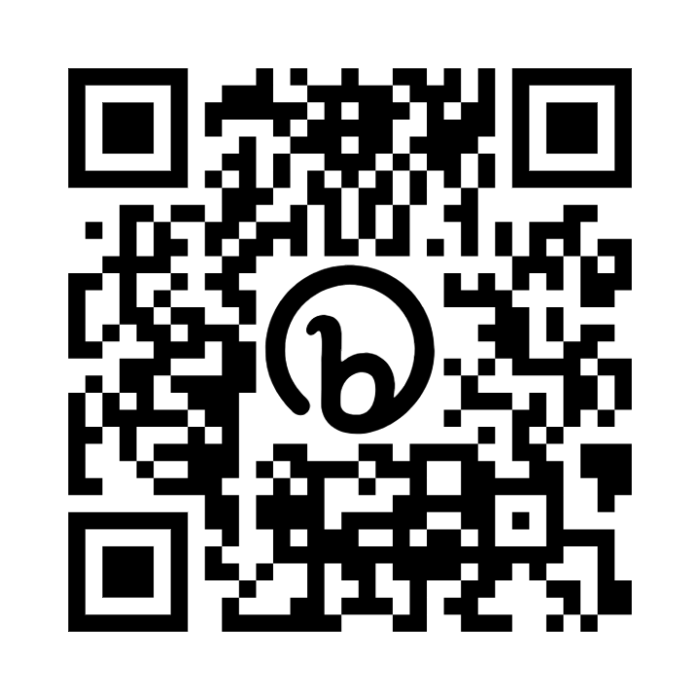
NAC Participation (Technology):
Sign-up to participate in our User Research session; using QR code provided in this slide.
Identify colleagues that can participate in usability studies.
Guide development of roadmap for the open-source tool.
Advise of recent advances for consideration.

Slide 37
Dissemination & Communication
Darren Wright

Slide 38
Communication Channels (1 of 2).
Newsletter:
Quarterly messaging.
Sharing information and updates in the fields of I D E A Part B and Part C data and data accessibility.
Upcoming training and TA opportunities.
New and existing resources promoting and detailing accessibility best practices and standards.
Website Content:
Populating and creating content for new pages.
Revising existing pages and web elements.

Slide 39
Communication Channels (2 of 2).
Social Media (LinkedIn):
Promote relevant Weiss Center developments, including upcoming opportunities, event participation, resources, and service offerings.
Organic, reactive engagement with I D E A data and accessibility partners, as well as the broader community of stakeholders and end users.
Universal TA – Webinars:
Coordination, facilitation, and execution of virtual engagements, featuring accessibility and I D E A subject matter experts, focused on content of need as informed states and stakeholders.

Slide 40
NAC Participation (Communication):
How can we improve our communications across channels to better capture the perspectives of diverse individuals?
What tools, products, and/or resources would be beneficial to end users and states to further promote accessibility?
What revisions to existing products are required?
Thought partners for potential or proposed products and enhancements to engagement processes.

Slide 41
Evaluation
Judy Lee, True North Evaluation

Slide 42

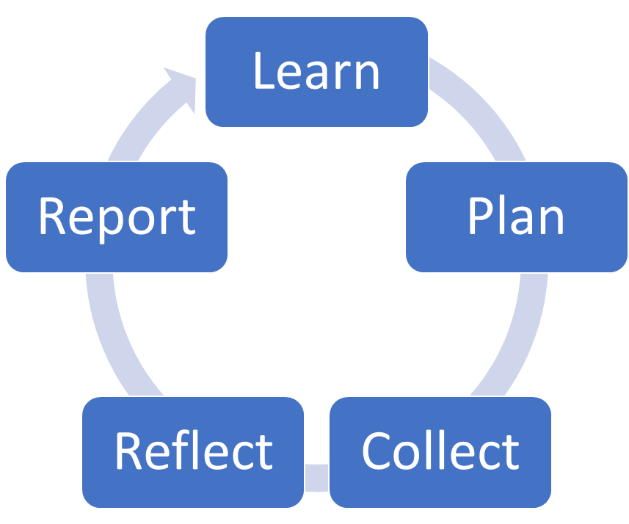
Evaluation Overview.
Approach:
Goals and Activities:
Approach:
Developmental Evaluation,
Results Based Accountability.
Methodology:
Mixed Methods,
Quantitative and Qualitative,
Process/Formative,
Outcome/Summative.
Tools:
Logic model, Evaluation Plan,
Annual Data Collection Schedule,
Monthly evaluation meetings,
Participation in other team meetings.

Slide 43
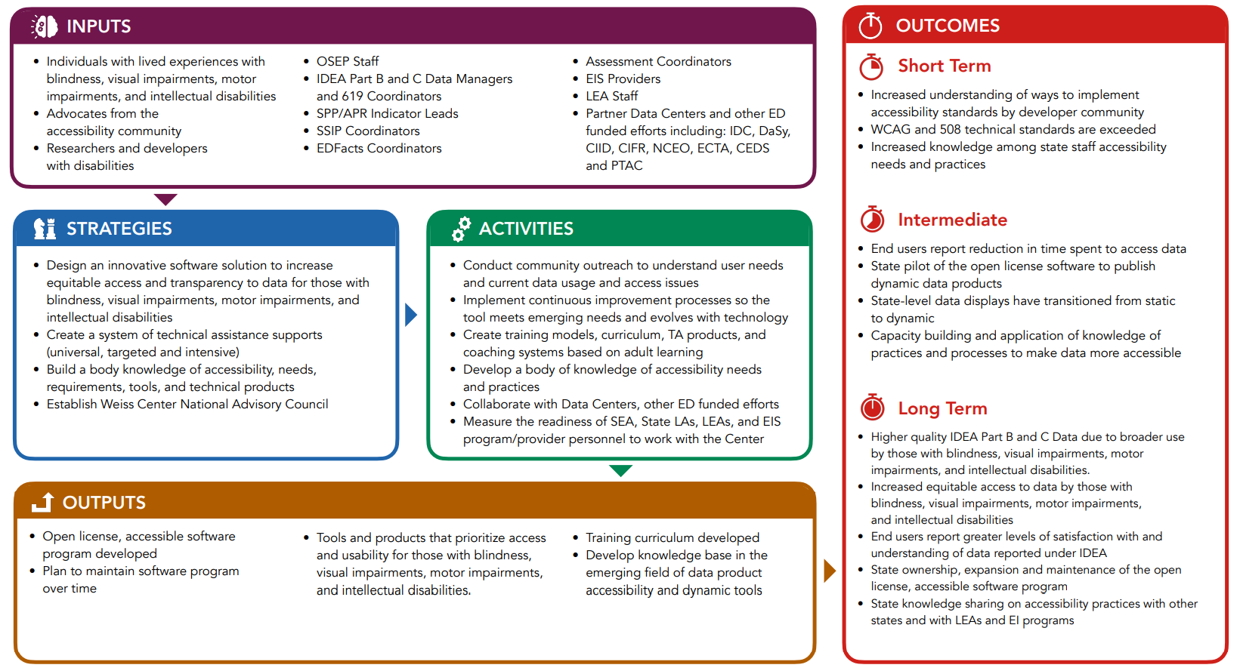
Evaluation Plan:

Slide 44
Data for Project Performance Measures.
Methods:
Sources:
Quality Assurance Review*,
Database Tracking,
Surveys,
Interviews (1:1, focus group),
Repeated self-assessments,
ITA Quality Rating Rubric,
Observation of TA.
UTA recipients,
TTA recipients,
ITA recipients,
TA providers and coaches,
Experts (e.g., NAC),
End users,
Partners.

Slide 45
Year 1 Evaluation Activities.
Processes:
Collaborate on Tool Development:
Evaluation meetings,
Participation in Leadership, TA, Staff, & other meetings,
Accessible data collection methods,
Annual Performance Report (APR),
Observation.
Data Collection Schedule,
Readiness Matrix,
Needs Assessment Survey,
Self-Assessment for ITA.

Slide 46
Year 1 Data Collections.
Webinars (Kickoff 4/20/23, Introduction to Disability 7/27/23):
OS3 Meetings in DC (May), Seattle (June), Atlanta (July):
Post-webinar evaluation survey,
38%-47% response rates,
Quality of webinar ratings 3.5-3.9 (4-pt scale),
83%-100% reported knowledge gains on multiple dimensions,
Formative feedback, audience roles, challenges with accessible data, levels of disability awareness, topics of interest.
Observation.
Post-meeting evaluation surveys:
88%-95% response rates,
Quality of meeting ratings 3.3-3.9 (4-pt scale),
Formative feedback, challenges with accessible data, levels of disability awareness, technology use.
Focus groups (2/meeting):
Feedback on meeting processes, activities, clarity of content.

Slide 47
Your Feedback

Slide 48
Wrap-Up and Next Steps
Fred Edora and Johan Rempel

Slide 49
What are the Next Steps?
Sign up for the quarterly newsletter,
Follow the Weiss Center on LinkedIn,
Bookmark the Weiss Center website (weissta.org),
The next bi-annual meeting of this council will be in Spring 2024; please watch your email to schedule that meeting,
Please contact us with any questions: contact@weissta.org or fred.edora@aemcorp.com.

Slide 50
Contact Information
Fred Edora – fred.edora@aemcorp.com
Johan Rempel – jrempel3@gatech.edu
contact@weissta.org

Slide 51
Thank you!
The contents of this presentation were developed under a grant from the US Department of Education, H373Q220002. However, those contents do not necessarily represent the policy of the US Department of Education, and you should not assume endorsement by the Federal Government. Project Officer: Eric Caruso.

